Slide 1
Weekly Updates
Slow-Pitch Softball
SDMAY25-11

Slide 2
This Week’s Pairings
01
Andrew and Sully
02
Casey and Ethan
03
Josh and Cameron
Core ML and YOLO.
Image pipeline management and height calculation testing.
Coordinate plane display.

Slide 3
Andrew + Sully
Fully integrated a YOLO model into our app via the Ultralytics/Flutter API
  Ultralytics API does not have a lot of customization options out of the box
  Had to modify the YOLO imports in order to orient the camera correctly
Acquired iPhone tripod for recording and testing
Started process of created custom trained YOLO model using Ethan’s Roboflow dataset

Slide 4

Andrew + Sully

Slide 5
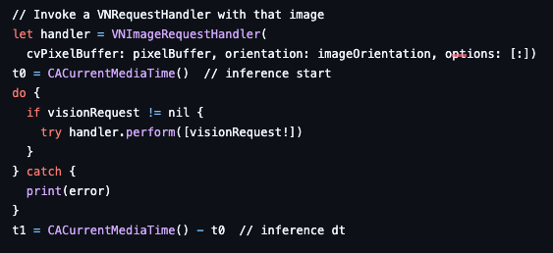
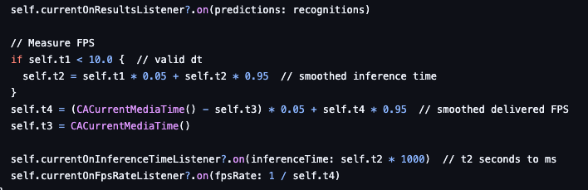
How FPS is being calculated within the YOLO-Flutter API
The API logs the time immediately before and after the model inference to measure prediction duration. It then applies exponential smoothing to stabilize this inference time, while FPS is calculated from the time difference between consecutive frames.

Slide 6
Casey + Ethan
We found Flutter handles function arguments by reference, so there is no image transfers between functions.
We tested the height calculations by self-identifying where the ball is located within the frame and found issues with the geometry calculations.
Relaxing a constraint: The home plate and pitcher’s mound should be horizontally aligned.
  Allowed for simple geometric calculations.
  No need for finding a pitching line or multiple reference heights.
  Reduced the setup to taking and marking one picture.

Slide 7
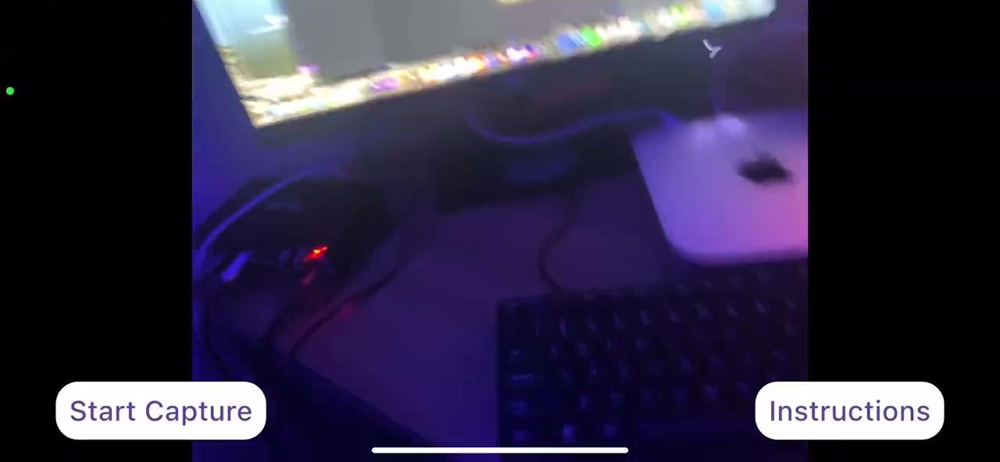

Slide 8
Josh + Cameron
Grid Coordinate System
We started to implement a rough implementation of a grid coordinate system that can be used for the camera part of our app
This can be used to better identify the scale of our camera visually
Also very useful to use for testing to identify how accurate our yolo models and box tracking may be when drawn and tested with a grid coordinate system
Improvements
This is a very rough estimate of what we might do and implement and may be further optimized to better account for our project and needs of this coordinate system
Can be made to look more appealing in the future as well as it isn’t that visually appealing

Slide 9
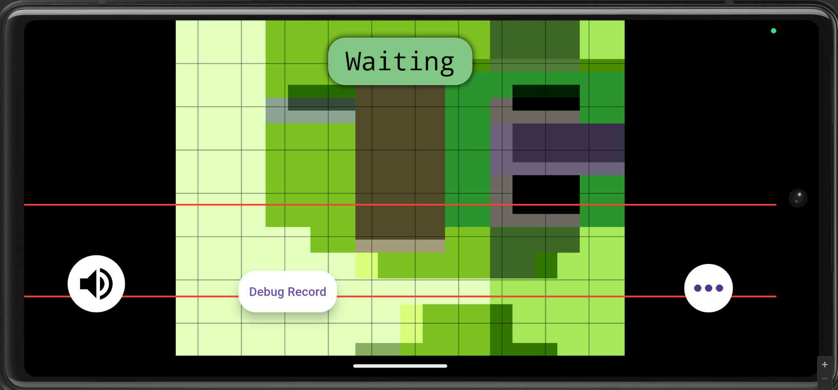
Josh + Cameron

Slide 10
Height Lines
More accurate height lines within the actual testing of the app.
Hard to fully test and know until used on a field with proper reference lines
Still needs to be further tested with more data

Slide 11
Next Week…
Integrate the Ultralytics YOLO model into the tracking process.
Continue with unit testing (Flutter / Tracking) and start full testing after.
Improve and modify grid coordinate system

